Slide 1



OMS Best Practices
Get The Most Out Of OMS

Slide 2

OMS Best Practices
The OMS Model
Data Integrity
Suggested Usage
Client
Server
Handling Cases
Preparing For A Major Event
Before
During
Notes:
Good day and welcome to this session for Futura Outage Management System OMS Best Practices.
Today we will be covering some OMS Best Practices to help you make the most of OMS. These are some of the best things you can do to ensure that OMS runs optimally for you and your staff.
We’ll touch on topics such as:
{CLICK} - The OMS Model
{CLICK} - Data Integrity
{CLICK} - Suggested usage
{CLICK} Client usage
{CLICK} Server usage
{CLICK} - Handling Cases
{CLICK} – Preparing for a major event (This is a big push for us this year to help ensure your OMS is running optimally BEFORE a major event hits). We will cover both:
{CLICK} – Before the Major Event
{CLICK} – And During the Major Event

Slide 3
Definitions
Calls
Calls come into OMS from many sources
Case
Outage situation – (CallBundle, Predicted, Confirmed)
OMS Model
Operational heart or brains of OMS
Client
Server
Windows CMD
Notes:
Before we dive in, let’s starts with a little refresher on some of the terminology we use in Futura OMS.
{CLICK} - Starting with calls. Put simply, a call is a report of an outage.
{CLICK} – It should be noted that this call can be derived from any source such as phone (UPN, CRC, IVR, AMI, etc.) Once they are inside OMS they are all treated the same, a building block to make outages and refine Cases, which brings us to…
{CLICK} - A Case is an outage situation and this includes the calls, device that is out and it’s phasing, assigned crews, notes on the calls as well as on the case, etc.
{CLICK} - The status of a case can vary as well to include; Call Bundles – which is an OMS prediction logic derived outage, Predicted Cases – a case that has been either Predicted by a dispatcher or has had a crew assigned to it, and finally Confirmed Cases – a case that the dispatcher has lineman confirmed status of the device as being out by having eyes on the device in question.
{CLICK} – OMS Model is the operational brains of OMS. It works in conjunction with SaveData to process outages and deliver to the database.
{CLICK} – The OMS Client is the actual computer that the dispatcher runs to view, track, assign and work an outage Case. It does not contain the database for OMS, it is simply a viewing tool with limited processing load.
{CLICK} – The OMS Server is where the OMS database resides and all processing is performed. All information both from and to the OMS Clients is handled on the OMS Server as well as any integrated information from other vendors.
{CLICK} – Windows CMD –is the command-line interpreter for the Windows OS. In OMS terms it is the black window running in the back-ground.
I previously mentioned Cases can have multiple statuses. Starting with Call Bundles then leading to Predicted Cases, Confirmed Cases and finally Restored or Closed. These are the general progression of an outage case within OMS, however, there are times when a case may be built directly on a device and status set directly to Predicted or Confirmed depending on the desired result.

Slide 4
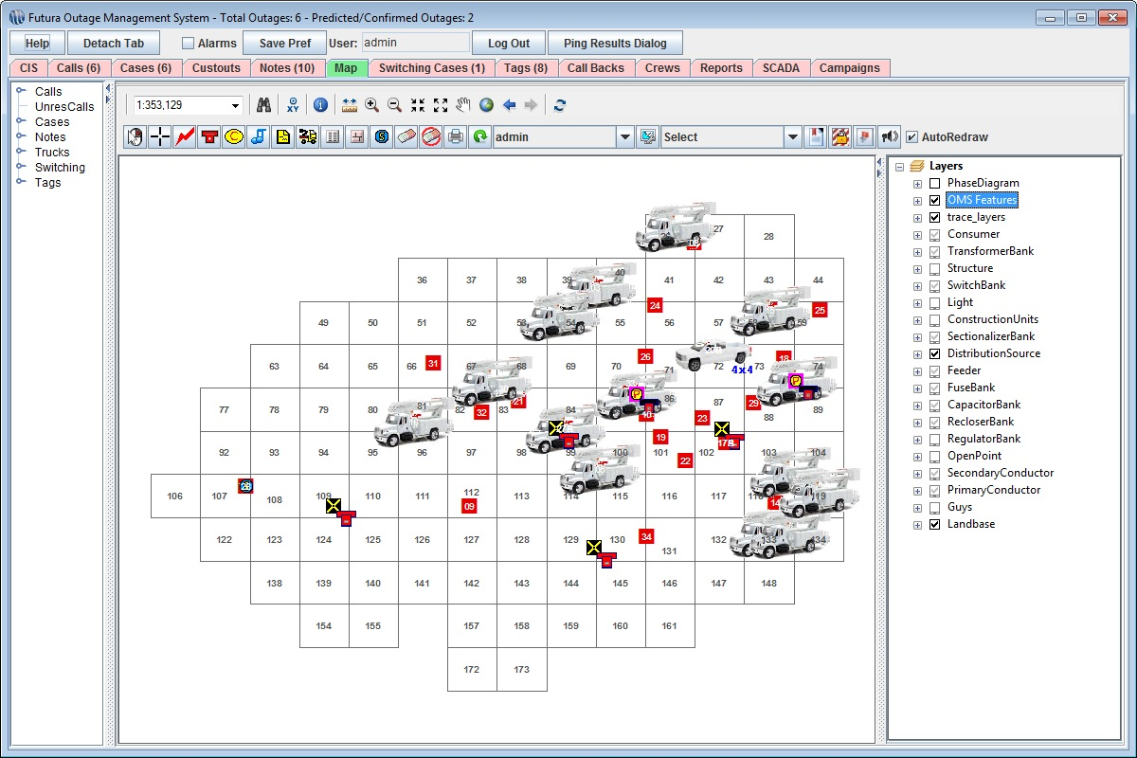
OMS Model
Foundation for all predictions
Syncs across CIS and GIS
GI/GO
Postgres integration
OMS Map MXD
Simple Symbology
Electric Network and Components
Clean and Light for speed
WHEN IN DOUBT, LEAVE IT OUT
Notes:
Now let’s take a closer look at the constituent parts of OMS. This course will serve as a bit of a review to some of you as well as provide some pro tips that will certainly help you in the future. The hope is that you will be able to take some or all of these tips and integrate them to your particular situation and incorporate them in to your business process for OMS.
We will be starting with the OMS Model which we just learned in the operational brains of OMS. If it isn’t running, OMS isn’t working. If it doesn’t have the required resources dedicated on the server, it isn't working optimally.
[CLICK] Your OMS Model is the foundation for all your predictions.
We use data from multiple sources to create this model.
The basic structure of the OMS model is taken from both your GIS and CIS [CLICK], that syncs via a manual data export from your GIS. This means that if the data exists in your CIS and you want it in your OMS it must also exist within your GIS.
[CLICK] Garbage In / Garbage Out – This applies aptly to your success with OMS. Remember the Model is only as good as the data we feed to it. If there is a failure inside the data in GIS; a duplicate line section on primary immediately before a fuse, for example, the behavior in OMS will be to end the flow at that Fuse as the most upline device for that trace. Any upstream calls that would normally roll this outage further toward the Breaker will simply create another outage upstream and leave you with two outages when there should have been one. I use this example to illustrate the extreme instance but it does help to illuminate why the data in GIS is so important to OMS.
[CLICK] We employ a PostGres database to store and control all aspects of OMS which is a remote database management system on the backend to communicate with all the data tables. PostGres will contain; the current network model stored in database flat files with parent/daughter relationships on each item that participates in the network, the active calls, cases, notes, vehicles, employees, lockout tags, switching cases, and any other OMS specific feature used, and finally all historical data required to track the history of an outage case and generate all reports available within OMS.
- [CLICK] When it comes to the mapping Tab of the model we want to emphasize an easy to understand map. In order [CLICK] to allow OMS to operate as efficiently and rapidly as possible you will want to keep the following points in mind when developing your OMS base map.
- You need to keep it clean and Light for speed. [CLICK] and you want to use simple, easy to understand symbology.
- This means we need to refrain from adding excessive Basemap or satellite layers for the sake of performance. [CLICK] you will want to ensure that you include mostly your Electric Network and Components that you need and not add the remainder.
- You have to remember we are trying to make predictions in real time and that the OMS model is pushing these updates to each and every client on the system. Having heavy basemap and satellite layers will slow down the performance of the OMS client. [CLICK] You ensure good speed for map performance by keeping this map Clean and Light. This does not mean you cannot have these layers if you really need them but they need to be set up in the MXD in a way that they only display when turned on or at a very large scale (IE - when zoomed in very close). The basic rule here would be [CLICK] “when in doubt, leave it out”.

Slide 5
Server Usage
Server
Only one login
DO NOT LOG OUT
Free up RAM
Monthly maintenance
Limit connections to the server
Notes:
Let’s continue with our journey of OMS Best Practices by moving on to the usage of the OMS Server. I want to preface this particular section in today’s training with saying that if you are unsure about any aspect of accessing the OMS Server please stay away from it, contact OMS Support for assistance.
There are a few basic rules that apply to the OMS server and the client machines. If you observe these standard practices you will experience a smoother operating OMS overall.
Let’s start off by diving in to the OMS Server and some basic Do’s and Don’ts. One item that we have been making a big push on over the last year has been upgraded specifications for server and client computers. Like any other software, as FuturaOMS grows and adds new features it necessarily requires more power to operate efficiently. [CLICK] These are the most recent server specifications required to run OMS efficiently. It is also important to note that if you and your IT department decide to go the virtualized route that you must meet these specifications and that all resources MUST be dedicated exclusively for this OMS Server and NOT shared. This means that your local IT department should NOT be removing Cores and RAM blocks because their last system analysis told them that OMS is only using 20% of the allocated resources. While this may be a realistic scenario for 90% of the time, it is the 10% of the time when ALL of these resources are needed in a big outage situation that we plan for in the specifications. I encourage you to speak with your local IT about the type of OMS Server you currently have and how it is being managed locally. If any of you want to get a current set of specifications just let anyone at OMS Support know and we can send them right out to you. I want to point to one of the highlights [CLICK] in these specifications where we are asking to use Solid State Drives. We have several clients who have made the move FROM a virtualized OMS Server back to a physical server using Solid State Drives and are reporting very good results. In fact, they are also employing Solid State Drives in the Clients with major, appreciable increases in speed and stability for the dispatchers.
On the Server there are several hard and fast rules that must be followed:
[CLICK] Number one on this list is that you only access the OMS Server using the set up login, usually “futuraadmin”. This is because the Integration Service can only run under one login. Local IT can access with an admin login but they should not attempt to do anything with OMS under any circumstances using other logins.
[CLICK] Never ever log out of the OMS Server, only disconnect. If you log out OMS will not continue to operate.
[CLICK] Free up RAM on your OMS Server by ensuring that there are no unnecessary programs or processes running.
[CLICK] Perform monthly maintenance when you can by completely taking the server down and restarting. Ensure that the OMS Model is back up and running – if you have any questions, contact OMS staff.
[CLICK] Finally be sure to observe limited connections to the OMS Server. Generally we like to limit to 5 clients or less during large outage situations but more can connect if needed.

Slide 6
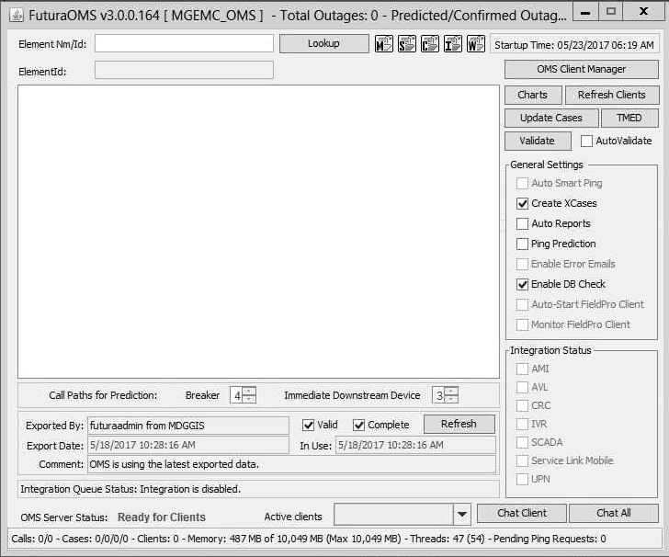
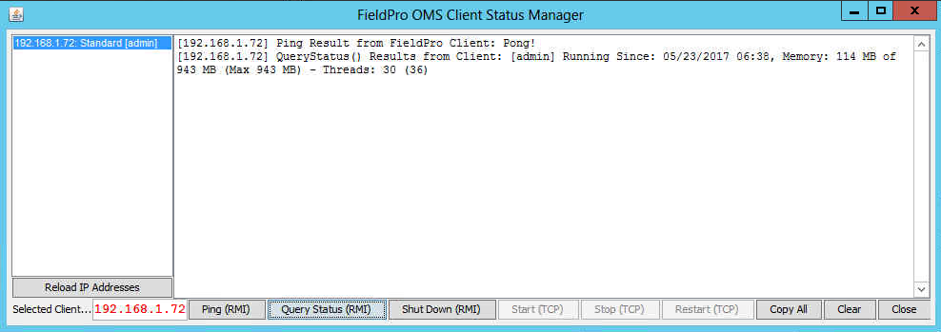
Server Usage
Server
Verify connections
Notes:
On the server in the all current builds of OMS there is a very useful tool called OMS Client Manager located on the OMS Model Window. The Tool [CLICK] is located here
We will want to use this tool to verify the active connections to the model. It is good practice to do this BEFORE a major storm begins in order to limit the numbers of connections to the model to just the required staff and no more. If others not directly linked to dispatch have a need to see the outage status you should point them to the various other tools that work with OMS, such as; the OMSWebMap, Catalyst or even FieldProOMS on an iPad. The idea is that the critical updates should be prioritized to the people responsible for getting the linemen to the outage devices and that timely updates can be pushed to the periphery using one of these other interfaces for individuals needing outage updates.
Once we open the [CLICK] tool we can see the active [CLICK] connections listed here in the left column. And we can [CLICK] Ping the Clients and see [CLICK] the results in the main window.
Likewise, we [CLICK] can query the status of the Clients using the Query Status button. And just as with the Ping results [CLICK] we can view the Status results in the main window.
This can come in very handy when trying to diagnose an under performing client as you can see the current RAM usage and threads with the maximum allowed threads in the parentheses.

Slide 7
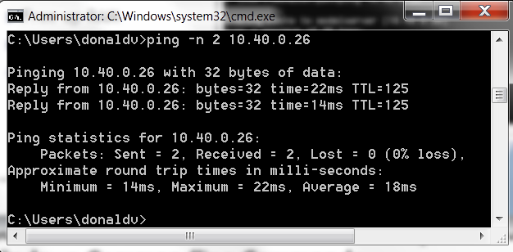
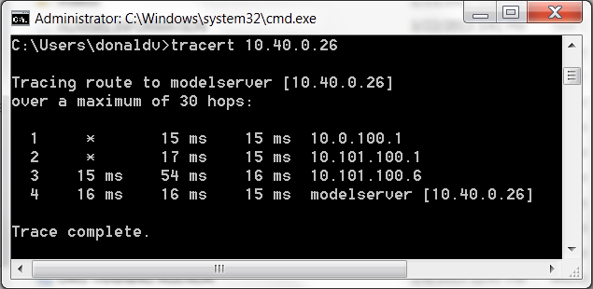
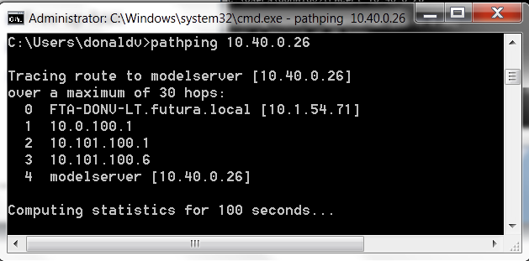
Client Usage
Client
Strong Network Connection
Free up RAM
Close programs
Take client down between shifts
Ping –n 100 [IP OMS CLIENT]
tracert [IP OMS CLIENT]
pathping [IP OMS CLIENT]
Notes:
While we had rules for the OMS Server we also have rules that apply to the OMS Clients. Among these are:
First, [CLICK] you will need to make sure you have a strong connection to the server across your network. This includes ensuring that not only the connection is made but that there is no noise on the connection and that there is minimal or no packet loss. We cannot stress this enough; if the network connection between the clients and the server is noisy, has drop-outs or completely goes down, OMS at the Client level will cease to function. There are a few ways, from the user level, to test the connection using a series of Windows CMD Commands. You can open the Command Line by going to Windows Start and in the RUN type in cmd and enter.
[CLICK] tracert will return all jumps via IP address from the OMS Server to the Client. It can help ID problems where switches and routing are concerned.
[CLICK] pathping provides information about network latency and network loss at intermediate hops between a source and destination. Pathping sends multiple Echo Request messages to results based on the packets returned from each router.
[CLICK] if pathping shows some latency and packet loss you will want to run a special ping on the IP or IPs that have the loss. The results will show you how much loss you have and give your local IT something to look at when you are having issues. Here I just ran this over 2 iterations but you will want to do hundreds (500 is a good test).
[CLICK] Just like we wanted to ensure that there is minimal RAM usage on the server, we want to do the same on the Clients.
[CLICK] OMS performs at it’s peak when there aren’t many other open programs or processes running on the client computer.
[CLICK] Finally, ensure that the client computer is completely taken down and restarted between each shift in order to flush the RAM and processors and reset ports to ensure peak performance.

Slide 8

Handling Cases
Divide and Conquer
User for Call Bundles/Dispatch Trucks
User Predicted/Updating Notes
User to Restore Outages
Use Filters
Confirmed vs Predicted outages
Know Case Status (Predicted, Confirmed, Restored, etc.)
Notes:
Let’s move on to actually using OMS and Handling Cases:
The Approach we like to recommend that you take is [CLICK] to ‘Divide and Conquer’
in a Large Volume Storm Situation, you want to be able to strategically and efficiently handle cases.
From start to finish, from the very first call to marking the case as RESOLVED there needs to be a constant stream of communication.
Communication is critical from the CSR’s, to the dispatchers, to the linemen and back to the dispatchers and between the dispatchers.
We try to make events like these a bit less hectic by presenting the data in a way that’s easy to understand within the OMS Client Grid layout.
One thing you can do is Use Filters on Cases Tab to limit what cases users see within.
When it comes to Divide and conquer you can have [CLICK] one user working Call Bundles and dispatching trucks, [CLICK] another to handle the Predicted Cases and update Call/Case Notes, and finally [CLICK] another User to mark outages as resolved once you have power back up.
Have one user working Predicted cases to Confirm Outages
This person talks directly with lineman to input information coming back from the field.
Again I’d like to highlight the need for communication during all stages of an outage.
Have one user Restoring confirmed outages
This person is the only one to Restore an outage after all lines of communication verify that the outage is restored.
Once you have confirmation that the power is back on from the lineman, or pinging or IVR, this person should immediately restore the outage.
[CLICK] When it comes to interacting with the software we encourage using filters so that all the calls and bundles are organized and don’t become overwhelming.
We recommend you filter to only view each user’s specific status assigned. For the Call Bundles User they will filter out all but the Call Bundles in order to minimize distractions and confusion.
And we like to emphasize that you REFRESH to reveal the newest list of cases.
[CLICK] All Users should know the Case status at all times.

Slide 9
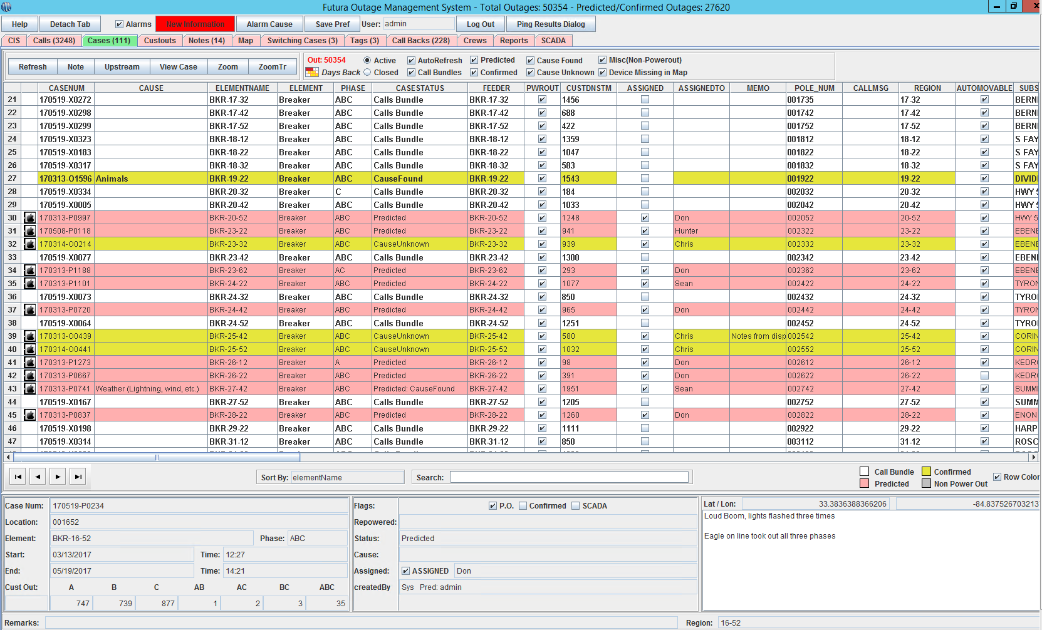
Handling Cases
Notes:
An example of this is like we see here [CLICK]. There are currently 111 cases in the system with 50354 customers out and some Call Bundles, Predicted Cases and Confirmed Cases. When faced with this sort of information overload the typical human being will panic and potentially make mistakes. As I noted earlier we like for you to use a Divide and Conquer technique when dealing with a rather large outage like we see here.
As I said we want to use the built in filters in OMS to limit the data the dispatcher sees at any given time. In order to do this a division of labor and responsibility should be used so that once a dispatcher finishes with a case it can be removed from their screen. This serves a practical purpose in that the data gets done and a mental purpose in that the dispatcher sees progress and only has to worry about a limited number of cases at any given time.
If we [CLICK] uncheck all but the Call Bundles boxes we will filter to only show…..

Slide 10
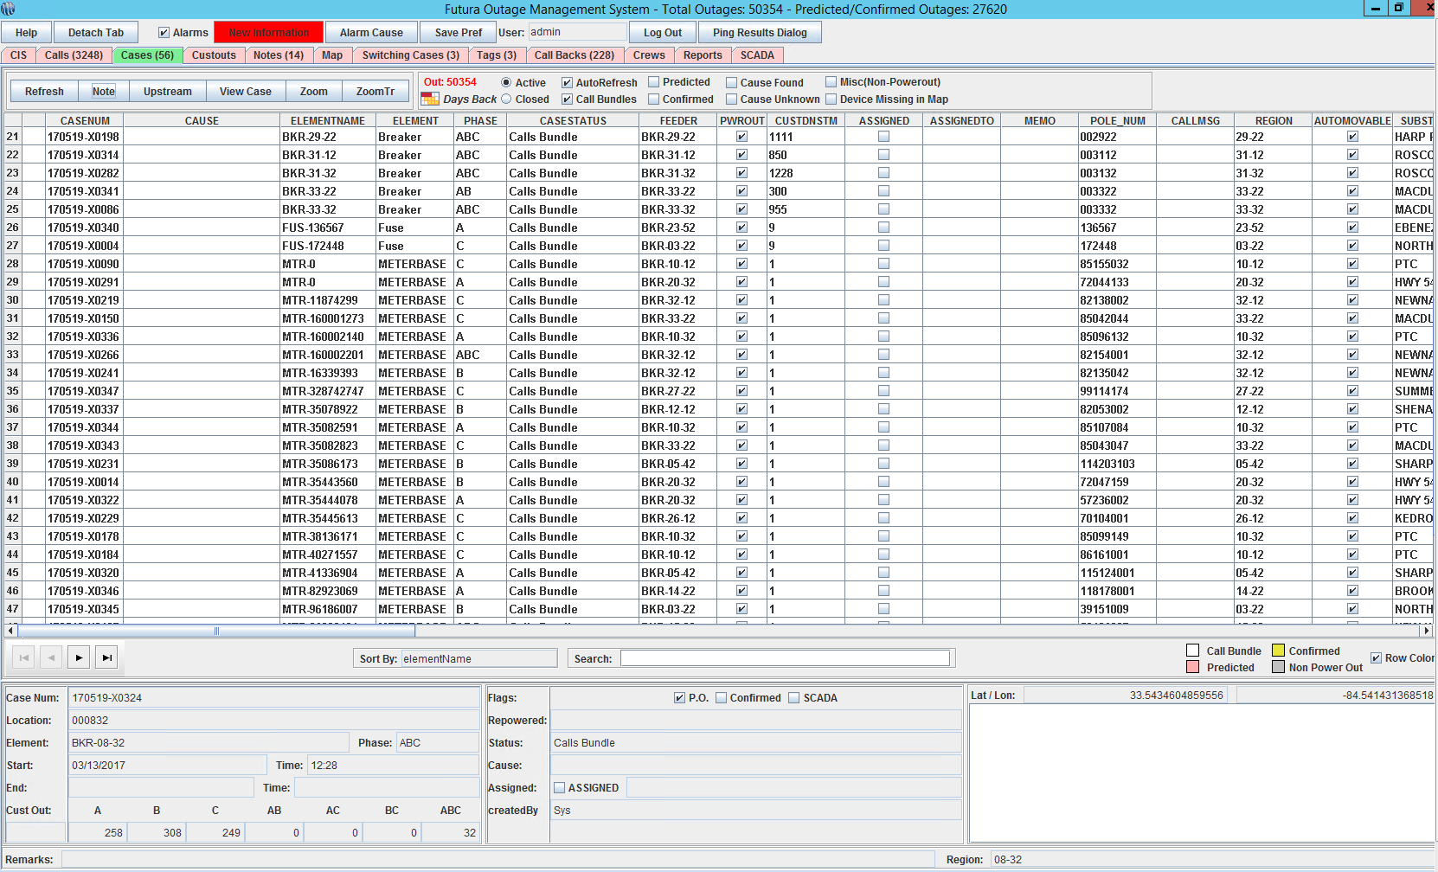
Handling Cases
Notes:
The current Active Call Bundles [CLICK]. Notice the filters only showing us the Call Bundles with nothing else checked. Of course AutoRefresh will remain checked for the time being. Notice that the total cases in the tab are now at 56. This will make it much easier to work these outages when the total has been cut in half for this dispatcher.
Now we will [CLICK] uncheck the Call Bundle filter and apply the Predicted filter to view…..

Slide 11
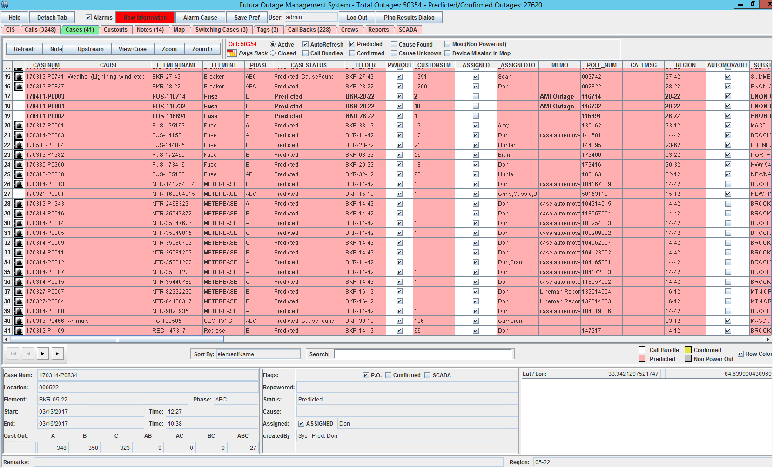
Handling Cases
Notes:
Currently Active Predicted Cases {CLICK}. Notice the filters only showing us the Predicted Cases with nothing else checked. As before we will want to ensure that AutoRefresh will remain checked for the time being. Notice that the total cases in the tab are now at 41. Just like we noted when we filtered to Call Bundles, filtering to Predicted Cases will make things much easier for the Dispatcher.
Now we will [CLICK] uncheck the Predicted filter and apply the Confirmed filter anlong with Cause Unknown and Cause Found to view…..

Slide 12
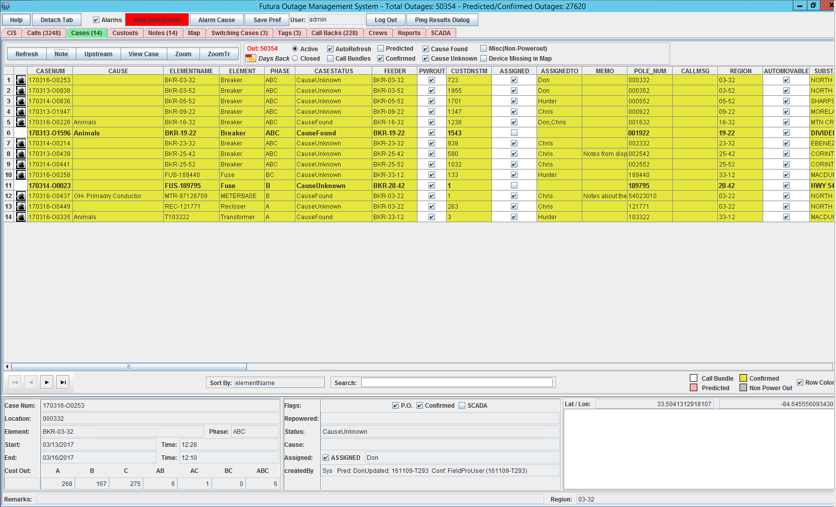
Handling Cases
Notes:
Currently Active Confirmed Cases {CLICK}. Notice the [CLICK] filters only showing us the Confirmed Cases where Cause is either found or unknown yet. As before we will want to ensure that AutoRefresh will remain checked for the time being. Notice that the total cases in the tab are now at 14. Just like we noted when we filtered to Call Bundles and Predicted, filtering to Confirmed Cases will make things much easier for the Dispatcher.

Slide 13
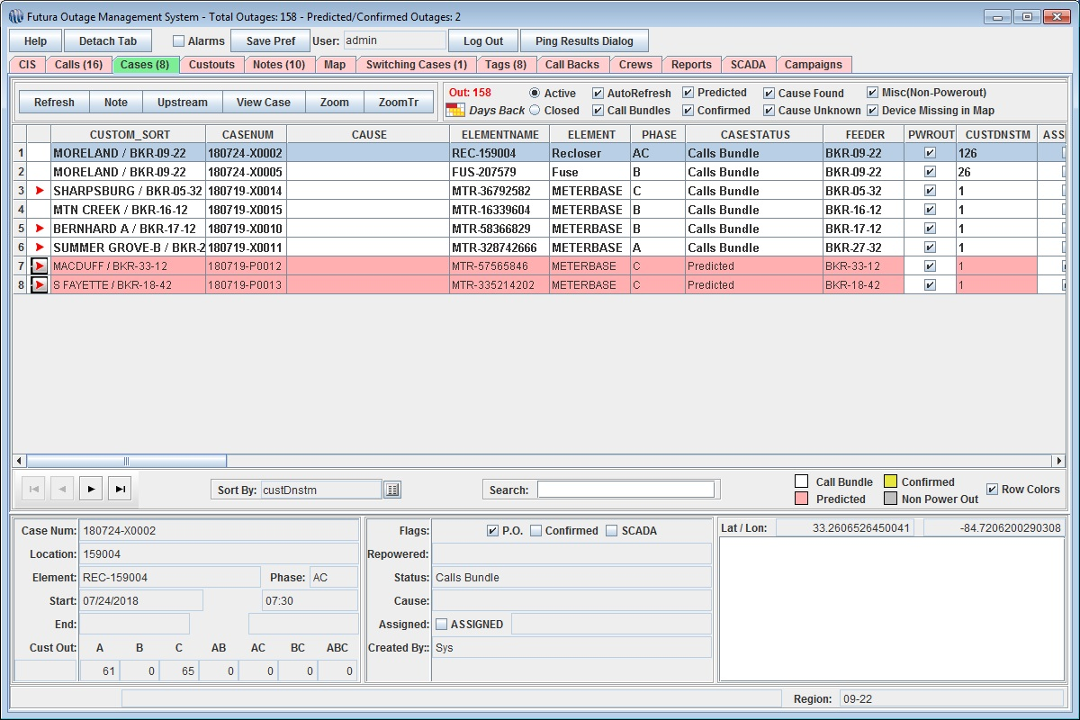
Handling Cases
Notes:
{CLICK} Now I’d like to go over a brief set of screenshots that go through each step of the process when handling an outage inside of the Client in FuturaOMS {CLICK}.
As seen here we have a call bundle.
A call bundle is created by OMS automatically as calls are logged in the system. It is nothing more than an OMS prediction of the most likely device out based on the number of calls logged in an area and what phase they are on.
At this point, nobody has made any edits to the case.
In this example, we have 16 calls, and 8 cases in OMS with 2 predicted cases and 6 call bundles, predicting a total of 158 customers out of power.
The best way to handle this is to look at the largest outages first because that is where you get the biggest bang return for your effort.
You can sort by the “CUSTDNSTM” (Customers Down Stream) in order to sort by total customers predicted out. [CLICK] Here we can see the biggest outage easily which is on all three phases of a recloser with 163 customers downstream

Slide 14
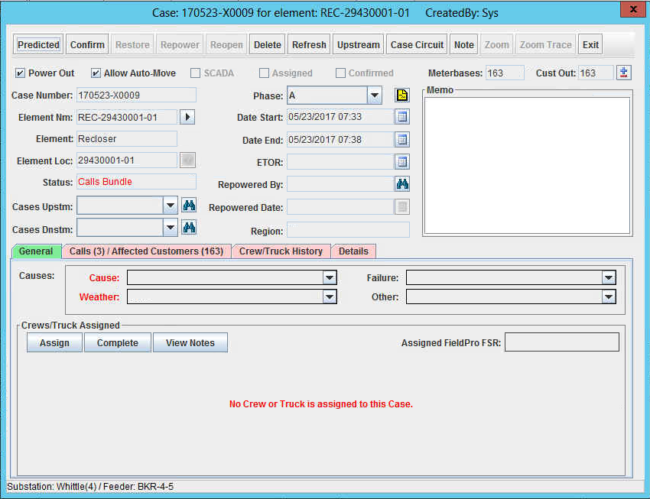
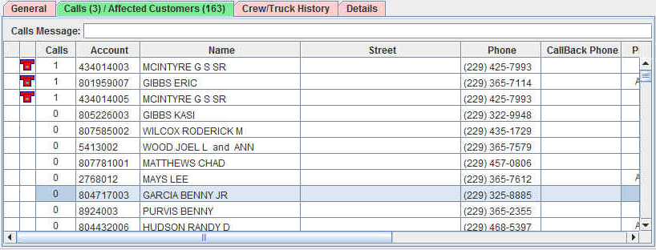
Handling Cases
Notes:
Now we've double clicked on the Recloser Case and we’ve opened the Case Ticket.
We can see more details about the call bundle here.
{CLICK} In this case, there are three calls in the system, and clicking the red Calls/Affected Customers tab would show us those calls.
These would be all the customers down line affected by this recloser.

Slide 15
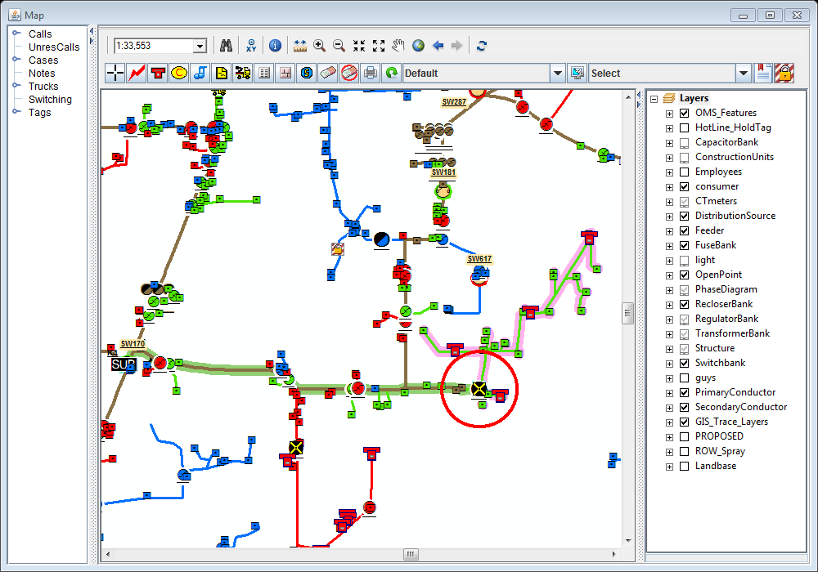
Handling Cases
Notes:
{CLICK} At any point in this process, we can look at the case on the map by using the Zoom and ZoomTr(ace) buttons {CLICK}. The Zoom button centers the map on the device in question, indicated by a red halo, and then highlights the area affected by the outage. {CLICK} ZoomTr, shown here, also highlights the upstream primary conductor back to the substation.

Slide 16
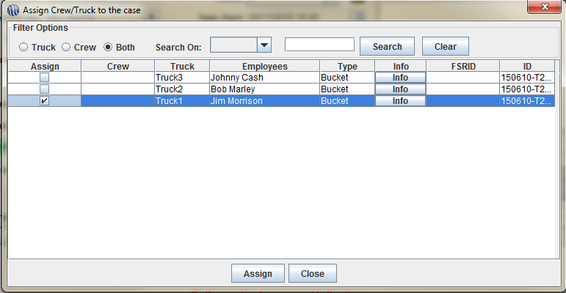
Handling Cases
Notes:
The first thing we need to do is assign someone out in the field to this case. So if we go back to our Case View (General Sub-Tab) we can assign it from there. Clicking the Assign button will open up a dialog box similar to the one shown here. Click the checkbox beside {CLICK} one or more employees and click the assign button to finish making the assignment.

Slide 17
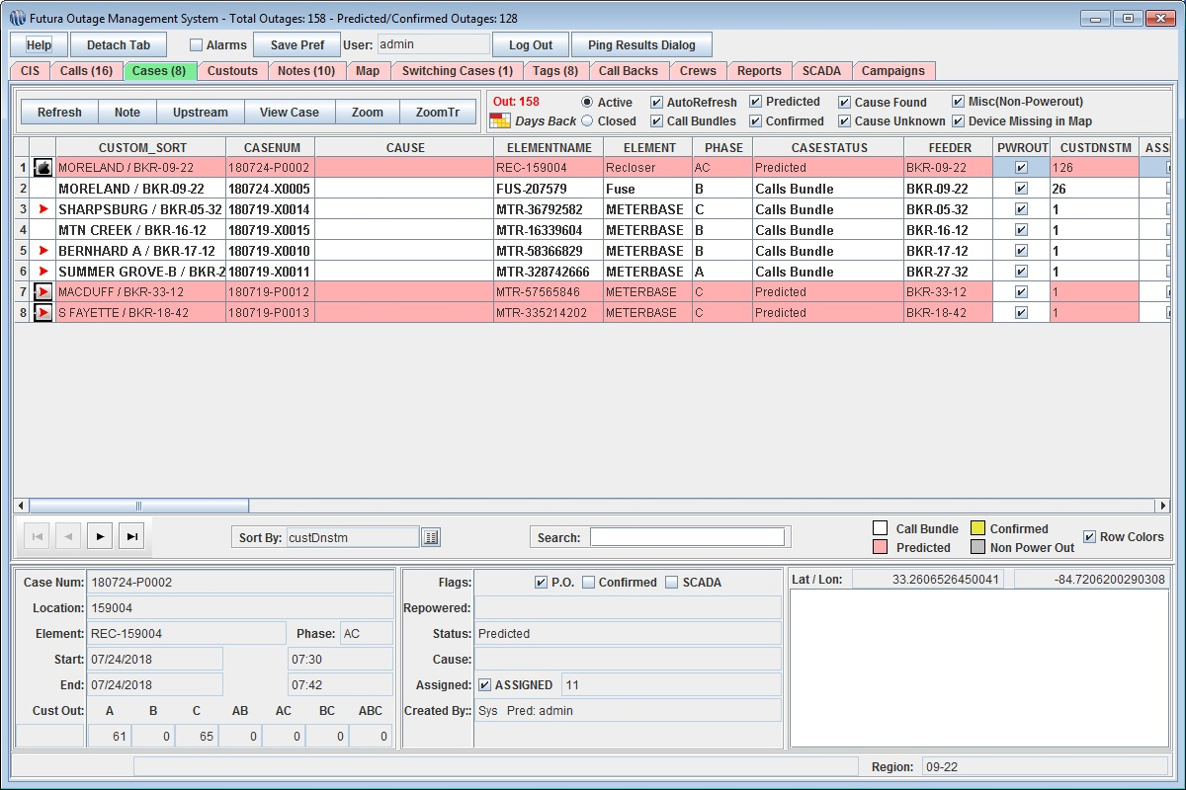
Handling Cases
Notes:
{CLICK} Now the case status has changes to A “predicted case.” A predicted case is one that has either been edited, or has a crew member assigned to it. A quick glance at the grid shows that predicted cases {CLICK} are highlighted in red. Another thing to keep an eye on is the text font of each case in the grid. Unassigned cases are always shown in bold text, which changes to normal text once an assignment is made.

Slide 18
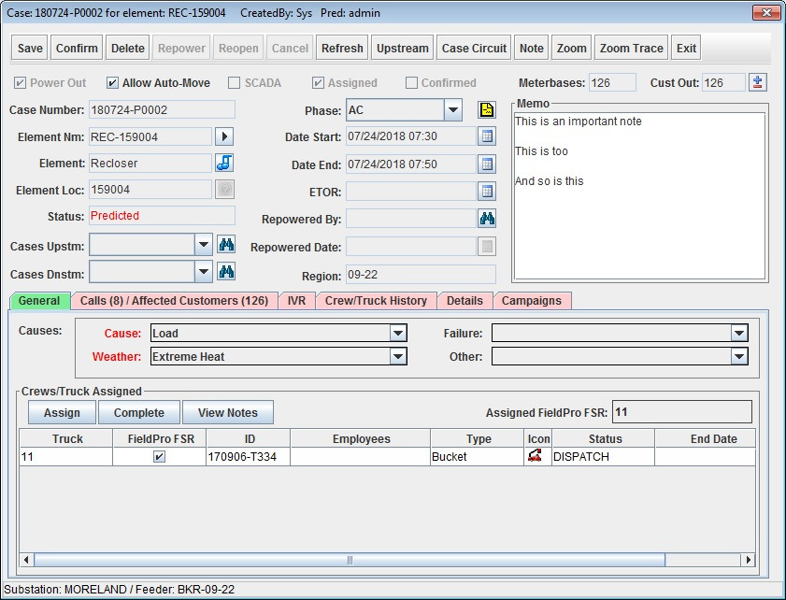
Handling Cases
Notes:
This step happens after you have heard back from the assigned lineman confirming the location of the problem. If the OMS prediction was correct, you can simply {CLICK} press the Confirm button. If not, clicking the arrows beside the {CLICK} Element Name and Phase will allow {CLICK}you to make any necessary changes.
At this point, if you have enough information to fill out the Cause, Failure, and Weather fields, you can do so. The options available in these fields may not match the image, BUT they are customized by each utility.

Slide 19
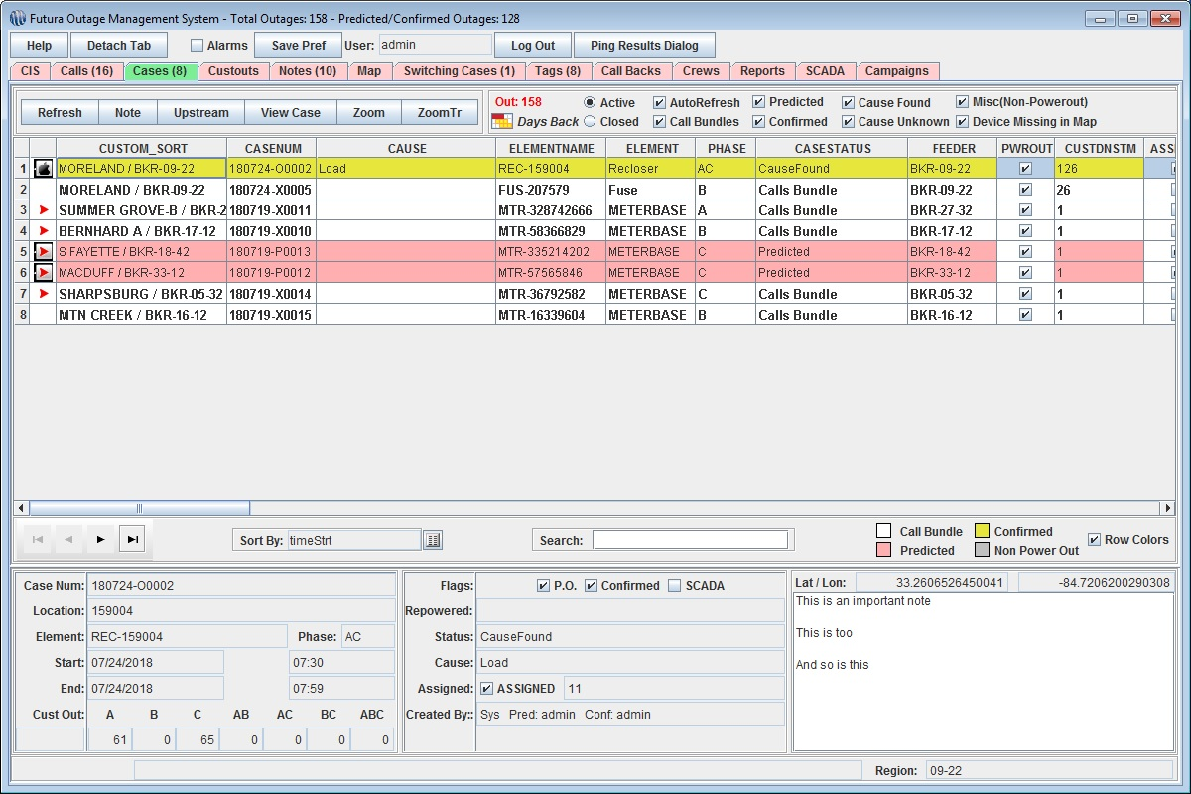
Handling Cases
Notes:
Now we are the stage in the process where a case has been Confirmed.
{CLICK} A confirmed case is one that has been checked by someone in the field, who verified that the device in question was out of power. A quick glance at the grid shows that {CLICK} confirmed cases are highlighted in yellow.
I mentioned previously that in severe storm situation you can filter out these cases because we know they’ve been addressed and often times there’s a man on site.

Slide 20
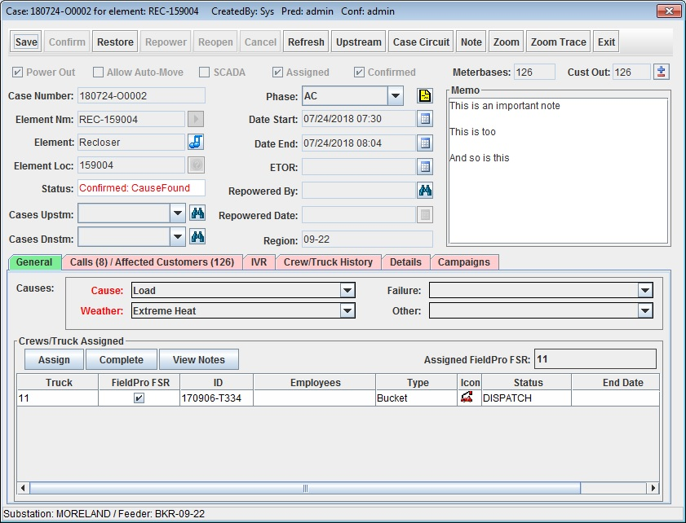
Handling Cases
Notes:
This step comes once power has been restored to the device. {CLICK} We will open the Case to begin the process while checking on a minimum of a few things.
Before clicking restore {CLICK}, it is a good idea to double check the start and end times for the outage. Most often, the Date End value may need to be adjusted back a few minutes to compensate for the time it took for the lineman to contact a dispatcher. This can be done by clicking {CLICK} on the calendar symbol beside the field and entering the desired time. If you do not change this value, it will default to the current time of the computer the client is running on. Once everything is correct just click Restore to close the case.

Slide 21
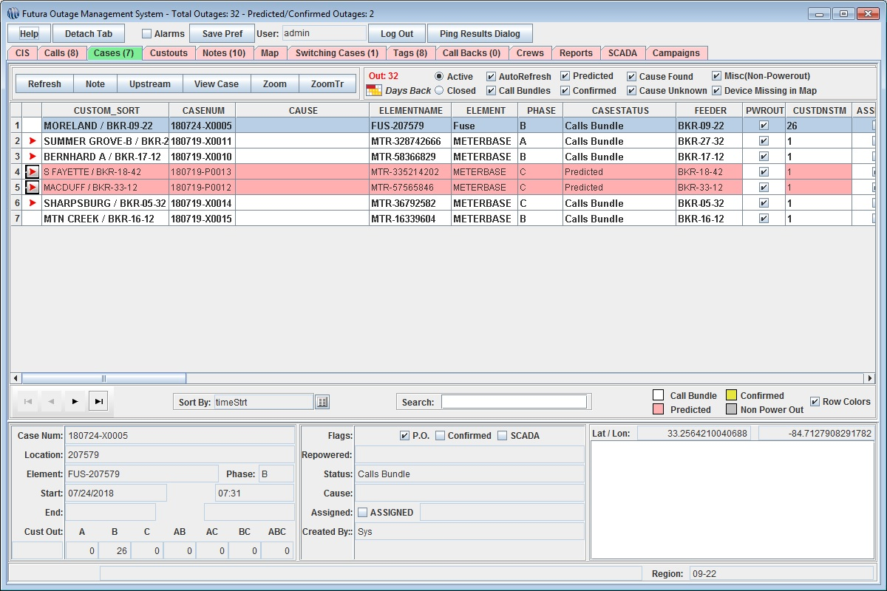
Handling Cases
Notes:
Case Closed –
After restoring, {CLICK} the case is closed and removed from the grid. The associated calls are also closed, so we now see only 8 calls and 7 cases, 2 Predicted Cases and 5 Call Bundles.
For handling the remainder of cases it’s a matter of REFRESH and REPEAT.

Slide 22
Preparing for a Major Event
OMS Model
Contact OMS Support BEFORE restarting the model
oms@futuragis.com
(678) 906-2575
Afterhours Support (678) 230-1082
Notes:
Let’s face it, you will have a major event hit your system eventually; it is not a question of if, it is a question of when. And when it does happen, it would be best to be prepared with a fresh OMS and a good game plan to manage the outage. Most importantly, if you ever find that you need to restart the OMS server due to a power outage in your office or other reasons, please contact OMS Support and allow us to assist before restarting in case we can figure out what the issue was. If you restart the OMS Model before contacting OMS Support we cannot determine what the cause was.
Here I have provided for you all conceivable ways to make contact with OMS Support, other than personal cell phones numbers.

Slide 23

Preparing for a Major Event - BEFORE
Set Verify Good Time
Set Map to “STORM MODE”
Set OMSWebMap Modals
Notes:
Some of the more general things you can do before the major event hits that will save a lot of headaches for all involved. These include:
{CLICK} Adjust the Verify Good Time setting to a reasonable time-frame. This controls the length of time verified outages will remain downstream. Once this time has been reached the case will re-predict using the Prediction Engine and will likely move back upstream to the verified device. Typical day-to-day Verify Good Time settings will usually be between 15-20 minutes. It is suggested that you set this to between 24-48 hours during a Major Event Outage.
{CLICK} Although it isn’t as big of a problem as it used to be, the map can still be a source of frustration during a Major Event Outage. In the OMS Tips & Tricks Block we discuss the idea of streamlining your OMS map to just the absolute necessities but we understand that sometimes you need the “heavy” layers that slow the map down. One way you can get around this is to set up a DEFAULT map mode for normal operations and a STORM map mode for the Major Event Outages. Essentially you will have a stripped down map that you can toggle to when it begins to get bad.
{CLICK} Update the INFORMATION OMSwebMap Modal if you serve this out to the public externally. This can get the message out to your customers for very little effort and reduce Call Volume. If you don’t know what this is or want more information on OMSWebMap Modals, be sure to sit in on Hunter’s INFO IN/INFO OUT Session.

Slide 24
Preparing for a Major Event - BEFORE
Disable all on Server and Clients
Anit-Virus
Disk Scans
Network Scans
Notes:
This may sound very scary to some but we have seen entire OMS systems go down simply due to a scheduled IT Scan. {CLICK} For this reason we ask that you have your local IT temporarily disable….
-{CLICK} Any anti-virus software on the server and clients
_{CLICK} Disk Scans that might be scheduled to run.
-{CLICK} All network scans that, again, might be scheduled to run.
Doing these steps will ensure that the network is free of unnecessary traffic and allow for the best possible communication between the server and the clients.

Slide 25

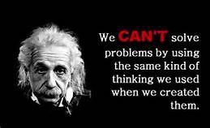
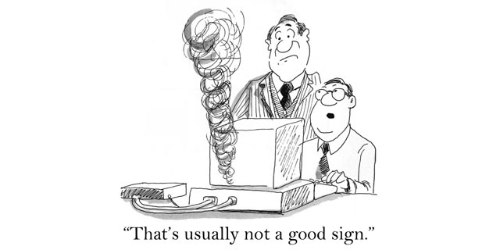
Preparing for a Major Event - BEFORE
Restart the OMS Server
Use the “RESTART” option
Restart the OMS Clients
Use the “RESTART” option
Completely Close Other Software
Notes:
Let’s face it, Windows is not a good manager of the resources allocated on any given computer running the OS. Windows 10 and Server 2012 have improved upon this but it still is far from ideal. For this reason we recommend that you:
{CLICK} Restart the OMS Server using the {CLICK} “RESTART” command. This ensures that a proper closedown happens and the startup usually runs faster and smoother.
{CLICK} Have your dispatchers and anyone else who will rely upon OMS Restart their Client computers {CLICK}Again, using the RESTART option as noted above and for the same reasons. Further, between shifts logout of the OMS Client and close it down completely, then start it back up with the next Dispatcher. Note that this is not required for day-to-day operations but we find that it helps performance during larger outage situations. We would NOT be opposed to a complete Restart of the client machines during these shift changes as well.
But why do we have to restart a modern computer? {CLICK} Basically, when restarting the computer, all evidence of any underlying errors is wiped away, whether you knew the error existed or not and whether the error had begun to affect performance or not, and the computer starts with a clean slate. All memory leaks, processor loops and networking issues are cumulative to some degree and can build upon each other.
So do we always need to Restart the computer? We certainly could take the time to track down any processes or applications that may be using excess resources and stop them. But other issues simply cannot be fixed while the computer is running and the answer why can be quite philosophical. {CLICK} Einstein recognized that problems cannot be solved from the same level of awareness that created them. In a way that’s also true for computers. We can stop a process and help resources but the state of the computer has changed and it is more likely that the offending state will return.
{CLICK} Finally, ensure that any and all unnecessary software on the Client is completely closed down. This is just to ensure there isn’t anything unrelated taking up resources that could be used for OMS.

Slide 26
Preparing for a Major Event - DURING
Notes:
Remember that all reports of outages are treated the same way once they get in to OMS. They are traced in the system and either placed in an existing outage as a call, placed in a new outage if none exists within it’s trace or placed in a new outage that is created from an existing outage due to the calls moving the case upstream. Let’s start off with what call volume coming in to OMS looks like in a major event.
{CLICK MANY TIMES}
This is a highly simplified graph of an actual call volume log form a Major Event that lasted nearly three days. The thing to note here is that there are peaks and valleys that happen throughout the duration of the event. When the event starts we get a flood of outage calls that eventually peak. Linemen will likely not be in the field until after the bulk of the storm passes so allow the influx of calls to build Call Bundles. During this time you should let OMS do it’s thing and process these call in to outage cases, tis not to say that you cannot or should not assign crews but remember that as the data floods in the outages you see initially will likely change over time so you are really just getting the linemen generally rolling in a trouble area and you can update them once they get in the area. Once the cases begin to hit upline devices go ahead and make assignments and then when the call volume begins to slow down you can work outages at will and assign.
{CLICK TO CONTINUE}
As the linemen begin to restore outages the call volume will begin to go down to a point and then the volume will go back up. This is because customers are seeing their neighbors lights come back on and a reporting again.
{FINISH CLICKING}
This pattern will continue throughout the event until finally the event is over and all customers are back in power.
Why do I show you this? It is to bring home that fact that during the build up and over the peak the OMS will be very busy as it on-boards all these call, processes then, traces them and places them in to cases or building new cases. This is a lot of information that has to be passed and processed. Let the system work and take it easy, it will necessarily take more time as more data is forced in to the system.

Slide 27
Preparing for a Major Event - DURING
SCADA
Prediction Engine
Tally Calls
AMI
Trees on line
Birddog
Notes:
Integrations within OMS can play a key roll in how good an outage goes. Lets talk about two major integrations that you are likely to have working in conjunction with your OMS.
{CLICK} If you have SCADA and you get alerted that Breakers have opened go ahead and get a Confirmed Case built on the Breakers. This helps to relieve pressure off the prediction engine and stops the usage of computer resources and network bandwidth.
{CLICK} It does this because it stops using the prediction engine and
{CLICK} Simply tallies new calls to tuck in to the existing Confirmed Case, this means there is no need to run a trace and all that comes with that.
{CLICK} Moving along, another integration that can help in an outage is AMI. But you should be very careful with employing AMI. AMI Responses can be a little off depending on how the storm damages the infrastructure of your system {CLICK} (think trees down across the line). Do not rely solely upon what AMI is telling you. You should wait for the {CLICK} birddog to get in the field before you fully Confirm those outages noted via AMI.

Slide 28
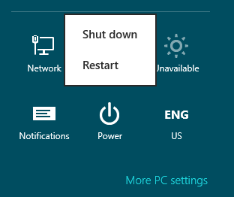


Preparing for a Major Event - DURING
Notes:
With the high volume of data that usually accompany any large outage event, it is very likely that you could experience some slowness with the client as OMS processes all the available data, creates and deletes cases, runs traces, includes data to both the calls and the cases and generally ensures that each client gets the latest information.
{CLICK} If this occurs, try to give OMS a couple of minutes to finish up whatever task it may be processing. Just let go of the mouse, and push away from the desk for a moment, you probably could use a minute or two to breathe anyway by this time.
{CLICK} If you find that it is completely not responsive, simply restart the client computer itself, but do not try to restart the OMS Server. Please notify OMS Support immediately if you feel the need to restart either the OMS Server of the Client.

Slide 29

Preparing for a Major Event - DURING
Notes:
And finally, limit the number of OMS Clients connected to ONLY necessary personnel. Instead use one of the other options for these non-essential personnel, such as Catalyst or OMSWebMap to follow the status along the way.

Slide 30

QUESTIONS?

